Slide 1
Cookie Doh! Proxy Server Based HTTPS Cookie Inspection and Obfuscation
By: James Cramton, Kathryn Linford and Alexander Everson

Slide 2
Obfuscation: The Inspiration
Obfuscation: A User’s Guide for Privacy and Protest
A book by Finn Brunton and Helen Nissenbaum
Incites revolution by inspiring ways to obfuscate our digital footprint.
Highlighted software banned by app stores as “malware” because they deliberately and directly circumvent Google’s business model.
Great examples from nature and technology
Orb weaver spiders leave desiccated prey in web as decoys for predators
Defeating enemy RADAR with chaff
Google banned “malware” that deliberately circumvented its revenue model
Track Me Not was a browser plug-in that performed random searches in the background to obscure true search profile
AdNauseum was a browser plug-in that clicked every ad on a page to obfuscate clicks
We need a solution that can’t be banned by app stores

Slide 3
How We Chose to Obfuscate
Obfuscation encourages identification of how you obfuscate your digital profile.
We will use obfuscation to:
Inform users about the cookies used to track them
Prevent individual exposure
Interfere with profiling
Cookie Doh! can be used by an individual; it can also be used collectively, but it does not rely on collective action
Cookie Doh! Works regardless of tracking software’s knowledge it is deployed
Not controlled by app stores
Prevents cookies or corrupts cookie data
Can adapt to changing tracking techniques
Google and others use cookies to track:
Individual users selectively
Aggregated users generally

Slide 4
A Modern Challenge
Initial plan was to write a proxy server in Python to inspect and modify cookies in HTTP headers
In 2014, Google started favoring HTTPS websites over HTTP sites for SEO
Widespread use of HTTPS makes intercepting header traffic a difficult
MITMProxy is an open source proxy server that facilitates inspection and modification of HTTPS content
MITMProxy permits inspection and manipulation of HTTPS headers, including cookies, for any system configured to use the proxy server
Technically, MITMProxy is a man-in-the-middle attack
It’s a tool intended for use on a local system to analyze your own traffic
MITMProxy supports custom scripted add-ons through a Python API

Slide 5
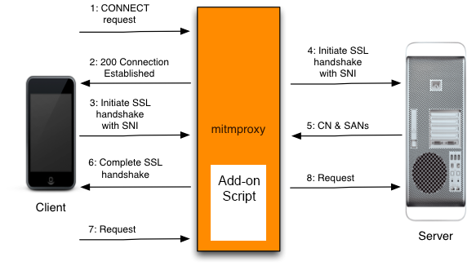
How MITMProxy Works
Client must trust the MITMProxy Root CA This is normally a Very Bad Idea
Technically MITMProxy is a Man In The Middle attack, so only practical to run locally
Could run as a hosted proxy service with full disclosure to customers, but IP may be banned
MITMProxy initiates separate SSL connections between:
Client and proxy
Proxy and server
MITMProxy allows python script add-ons to manipulate HTTPS traffic
Cookie Doh! Is our prototype of an add-on script to obfuscate cookie traffic using MITMProxy

Slide 6
Cookie Doh! Script Functionality
We wrote the Cookie Doh! Python script add-on to MITMProxy to:
Be impervious to app store bans as an open source proxy-based solution
Log cookie transactions between client and server
Study logged cookies to understand how websites use cookies to track behavior
Mask our digital footprint by removing cookies from HTTPS headers
Obfuscate our digital footprint by corrupting cookie data in transit
Can be enhanced to:
Improve the obfuscation techniques used to corrupt cookie data
Continue to evolve to handle future changes to cookie and pixel based tracking
Respond to trackers’ efforts to evade anti-tracking solutions

Slide 7
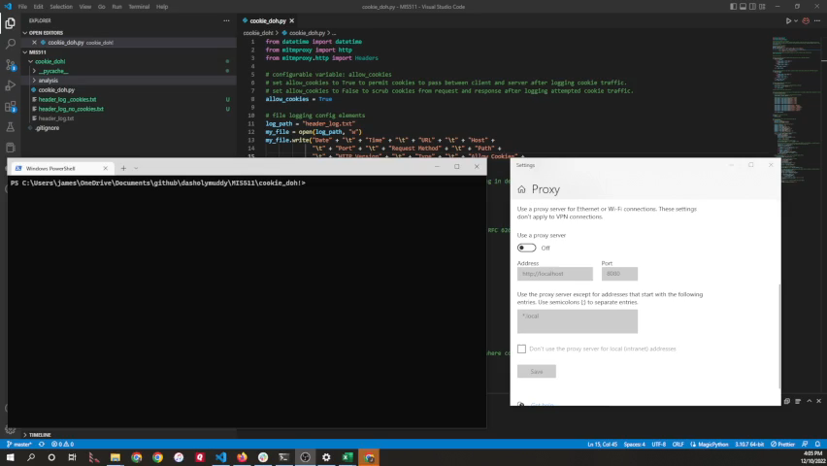
Cookie Doh! & MITMProxy Demo

Slide 8
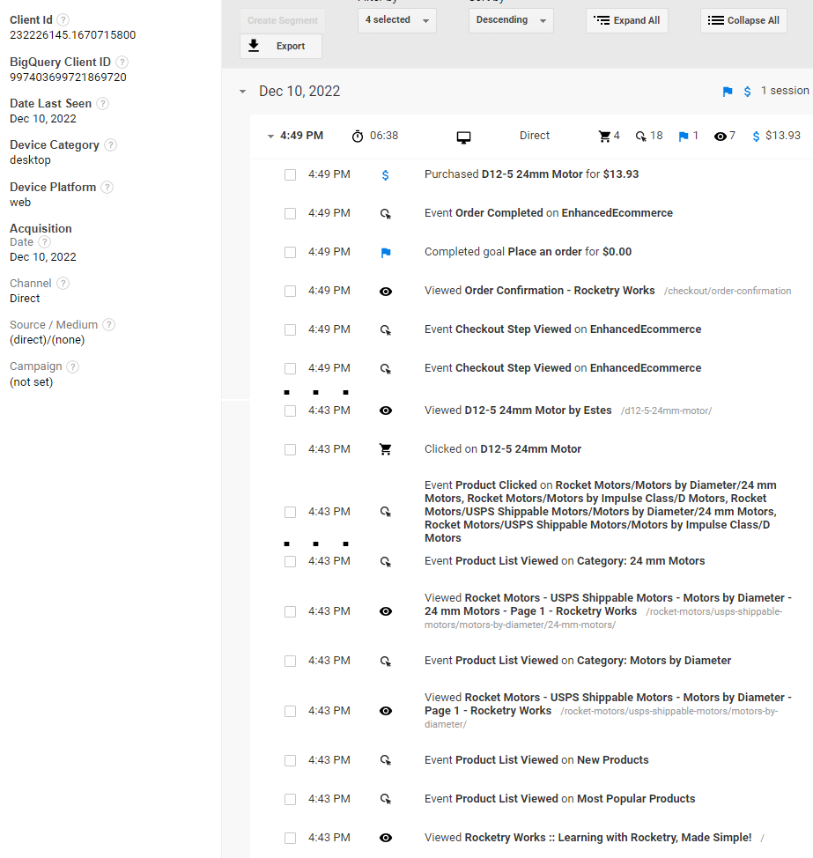
A Cookie Story: Google Analytics front and back ends
Methodology
Ran Cookie Doh! while placing an order on my own website
Identified purchase in my website’s Google Analytics’ Audience: User Explorer
Identified Client ID for purchase, searched for that value in Cookie Doh! log
Outcome
6 minute 38 second session produced 122 cookie transactions in Cookie Doh! log, representing 31 unique events in Google Analytics
No meaningful information found in the cookies other than the cookie value _ga=GA1.2.232226145.1670715800
The data stored in Google Analytics is linked to the Client ID, but is otherwise opaque in cookies

